Slide 1


Overview of Azure IoT Suite

Slide 2
IoT - Common patterns and practices
Azure IoT Hub is designed to connect your devices to Azure. It supports
Communication Patterns
Transport options
High throughput data ingestion
Reliable command and control
Notes:
Microsoft Azure IoT Hub provides capabilities for securely connecting, provisioning, updating and sending commands to devices. IoT Hub enables companies to control millions of IoT assets running on a broad set of operating systems and protocols to jumpstart their Internet of Things projects.
IoT Hub enables companies to:
Establish reliable bi-directional communication with IoT assets, even if they are intermittently connected, so companies can analyze incoming telemetry data and send commands and notifications as needed.
Enhance security of IoT solutions by leveraging per-device authentication to communicate with devices with the appropriate credentials.
Revoke access rights to specific devices, if needed, to maintain the integrity of the system.

Slide 3
Introducing Microsoft Azure IoT Hub
IoT Hub is available as a stand-alone service or as one of the services used in the new Azure IoT Suite
Azure IoT Hub is designed to connect your devices to Azure. It supports
Millions of simultaneously connected devices
Per-device authentication
High throughput data ingestion
Reliable command and control
Notes:
Microsoft Azure IoT Hub provides capabilities for securely connecting, provisioning, updating and sending commands to devices. IoT Hub enables companies to control millions of IoT assets running on a broad set of operating systems and protocols to jumpstart their Internet of Things projects.
IoT Hub enables companies to:
Establish reliable bi-directional communication with IoT assets, even if they are intermittently connected, so companies can analyze incoming telemetry data and send commands and notifications as needed.
Enhance security of IoT solutions by leveraging per-device authentication to communicate with devices with the appropriate credentials.
Revoke access rights to specific devices, if needed, to maintain the integrity of the system.

Slide 4
Azure IoT Solution Architecture
IoT Hub
Event processing and insight
(e.g. hot and cold paths)
1
0
1
1
0
0
1
1
0
0
0
1
1
0
1
0
1
0
1
0
0
1
1
0
IP-capable
0
1
1
0
1
0
Cloud protocol
gateway
0
1
1
1
Field gateway
Device business logic,
Connectivity monitoring
None IP-devices
Application
device provisioning and management
field
cloud
Notes:
Connecting your devices is the 1st challenge that you have when creating an IoT solution. There is a vast variety of devices you may want to connect. Some are internet capable and in that case you can connect them directly to Azure service (eg: IoT Hub) or you can use your own Cloud protocol gateway in case the device you are trying to connect does not have a protocol supported by IoT Hub (at this time AMQP or HTP). However, some devices are not internet capable and those devices need a field gateway to connect to the cloud. This gateway can do many things – not only connectivity and protocol translation but on the application back end side, one of the most important use cases is telemetry. You usually want to have an event processing and insight pipeline and IoT Hub will allow you to get a feed from the devices and events easily.
The 2nd big component that IoT solutions have with cloud is device big logic that takes care of interactive scenarios of your solutions – think about opening your car door or adjusting your home thermostat from your smart phone or sending a command to a device to update a piece of firmware.
Finally IoT Hub has to know which devices have to connect and which devices are present for IoT solution. For this purpose it has to interact with the visioning and management component which is the component that makes sure that the devices are on-boarded and de-provisioned correctly from your own IoT solutions.

Slide 5
Why use IoT Hub?
Device-to-cloud messaging
Cloud-to-device messaging
Scale up to millions of simultaneously connected devices
Device authentication & security
Service-facing device connectivity monitoring
IoT protocols, device resource optimization
Notes:
You might be wondering why you need IoT Hub in the first place. After all there are service in Azure that allows you to perform the device to cloud messaging – for instance using service bus.
IoT Hub in addition to communication patterns adds other value propositions to your IoT solutions. It scales up to millions of simultaneously connected devices you do not have to scale those services on your own. These communication patterns will scale with you just by increasing the # of units in your IoT deployment.
IoT Hub supports per device authentication and security. Per device authentication is fundamental because you want to have fine grain control on which devices access your solution and you want to make sure that you are sending commands to the right devices. This per device authentication and per device identity is embedded and designed into the communication pattern in the device to cloud messaging and cloud to device messaging.
There is also service facing monitoring. IoT solutions usually have the problem that devices cannot be reached without a cloud connection. Mostly it requires someone physically going to the device location to deliver maintenance on it. Since this is the case, it is very important to have monitoring on the status of each and every piece of communication.
Finally, IoT Hub supports many IoT protocols and is designed to support constrained devices, where device is retrained in networking resources, power resources or computational resources.
Of course, your IoT solution might need different communication patterns. You can thinking about uploading or downloading files or using real time proxy strategy like an HTP or WEB API. These patterns while they are not currently supported in IoT Hub do benefit from IoT Hub in many ways and we do provide guidance on how to implement them.

Slide 6
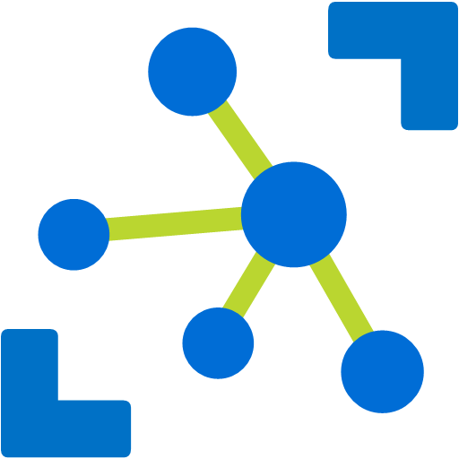
Communication Scenarios
Telemetry
Inquiries
Commands
Notifications
Information flowing from a device to other systems for conveying status of device and environment
Requests from devices looking to gather required information or to initiate activities
Commands from other systems to a device or a group of devices to perform specific activities
Information flowing from other systems to a device (group) for conveying status changes

Slide 7









Inside the IoT Hub
Events
Devices
IoT Hub
Machine Learning
Cosmo DB
Stream Analytics
Messaging
Function App
Logic App
Custom

Slide 8
Inside the IoT Hub
State
Devices
IoT Hub
Function App
Twin
Tags
Desired
Logic App
Reported
Custom

Slide 9
Information Exchange Patterns Basics of IoT Communication
Events
Messaging
Methods
State
Massive stream of information. Managed outside the IoT Hub
C2D communication using a pub/sub pattern using topics & subscriptions
Devices exposes methods that can called from a external applications using a request/response pattern
Device state is exchanged using device-twin configuration stored in the IoT Hub.

Slide 10
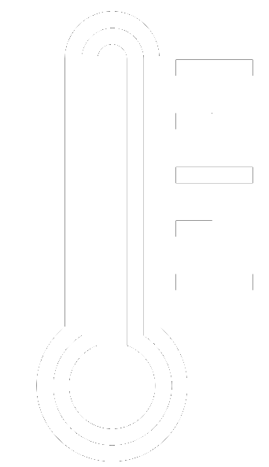
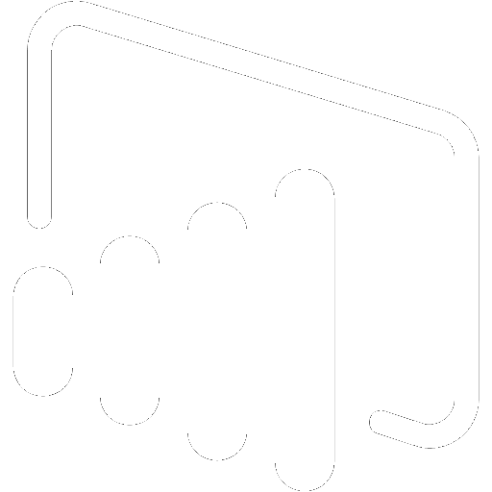
A sample scenario - Demo #1
Simulated thermometer
Emits telemetry every second
Stream Analytics
A Stream Analytics Job receives the readings and forward all readings to Power BI and Service Bus
IoT Hub
Event Processor
Stream Analytics
Power BI
Notes:
The sample scenario used in the demo.
A console simulator represent an individual wind turbine, emitting telemetry every second.
Also it simulates wind turbine start ad stop lifecycle, controlled by the cloud.
The main portions of the demo are:
provisioning: a simple portal app provisions devices with a device registry (implemented in a DocDB in the demo) and the hub identity registry.
The previous step enables a device simulator to connect to the hub and start emitting telemetry and listen for commands.
Telemetry is received by a console app running an Event Processor Host, which updates the portal with the latest telemetry values.
From the portal we can then send commands, which are recorded in a command store (to keep track of the status of each command).
The simulators reacts to the commands and send responses back through the D2C stream. The event processor then can distinguish command responses from telemetry messages and update the command store accordingly.

Slide 11

A sample scenario – Demo #2
Simulated thermometer
Emits telemetry every second
Stream Analytics
A Stream Analytics Job receives the readings and forward all readings to Power BI and Service Bus
Function App
An Azure function receives readings from queue and notifies device
IoT Hub
Event Processor
Stream Analytics
Power BI
Message Processor
SB Queue
Function App
Notes:
The sample scenario used in the demo.
A console simulator represent an individual wind turbine, emitting telemetry every second.
Also it simulates wind turbine start ad stop lifecycle, controlled by the cloud.
The main portions of the demo are:
provisioning: a simple portal app provisions devices with a device registry (implemented in a DocDB in the demo) and the hub identity registry.
The previous step enables a device simulator to connect to the hub and start emitting telemetry and listen for commands.
Telemetry is received by a console app running an Event Processor Host, which updates the portal with the latest telemetry values.
From the portal we can then send commands, which are recorded in a command store (to keep track of the status of each command).
The simulators reacts to the commands and send responses back through the D2C stream. The event processor then can distinguish command responses from telemetry messages and update the command store accordingly.

Slide 12


A sample scenario – Demo #3
Simulated thermometer
Emits telemetry every second
Stream Analytics
A Stream Analytics Job receives the readings and forward all readings to Power BI and Service Bus
Function App
An Azure function receives readings from queue and notifies device
Device State
Device receives update Desired State and adjust thermostat
IoT Hub
Event Processor
Stream Analytics
Power BI
Message Processor
SB Queue
Function App
Manage State
Notes:
The sample scenario used in the demo.
A console simulator represent an individual wind turbine, emitting telemetry every second.
Also it simulates wind turbine start ad stop lifecycle, controlled by the cloud.
The main portions of the demo are:
provisioning: a simple portal app provisions devices with a device registry (implemented in a DocDB in the demo) and the hub identity registry.
The previous step enables a device simulator to connect to the hub and start emitting telemetry and listen for commands.
Telemetry is received by a console app running an Event Processor Host, which updates the portal with the latest telemetry values.
From the portal we can then send commands, which are recorded in a command store (to keep track of the status of each command).
The simulators reacts to the commands and send responses back through the D2C stream. The event processor then can distinguish command responses from telemetry messages and update the command store accordingly.

Slide 13

A sample scenario – Demo #4
Simulated thermometer
Emits telemetry every second
Stream Analytics
A Stream Analytics Job receives the readings and forward all readings to Power BI and Service Bus
Function App
An Azure function receives readings from queue and notifies device
Device State
Device receives update Desired State and adjust thermostat
Device Method
Use device methods to call a method declared on the device
IoT Hub
Event Processor
Stream Analytics
Power BI
Message Processor
Custom App
SB Queue
Function App
Manage State
Notes:
The sample scenario used in the demo.
A console simulator represent an individual wind turbine, emitting telemetry every second.
Also it simulates wind turbine start ad stop lifecycle, controlled by the cloud.
The main portions of the demo are:
provisioning: a simple portal app provisions devices with a device registry (implemented in a DocDB in the demo) and the hub identity registry.
The previous step enables a device simulator to connect to the hub and start emitting telemetry and listen for commands.
Telemetry is received by a console app running an Event Processor Host, which updates the portal with the latest telemetry values.
From the portal we can then send commands, which are recorded in a command store (to keep track of the status of each command).
The simulators reacts to the commands and send responses back through the D2C stream. The event processor then can distinguish command responses from telemetry messages and update the command store accordingly.

Slide 14
Transport protocol – Functional comparison
AMQP / AMQP-WS
Support Complete, Reject and Abort on receiving messages.
Support message Meta data
MQTT / MQTT-WS
Supports Device State
Supports Device Methods
http://vasters.com/blog/From-MQTT-to-AMQP-and-back/

Slide 15
A sample scenario
Simulated thermometer
Emits telemetry every second
Stream Analytics
A Stream Analytics Job receives the readings and forward all readings to Power BI and Service Bus
Function App
An Azure function receives readings from queue and notifies device
Device State
Device receives update Desired State and adjust thermostat
IoT Hub
Event Processor
Stream Analytics
Power BI
Message Processor
SB Queue
Function App
Manage State
Notes:
The sample scenario used in the demo.
A console simulator represent an individual wind turbine, emitting telemetry every second.
Also it simulates wind turbine start ad stop lifecycle, controlled by the cloud.
The main portions of the demo are:
provisioning: a simple portal app provisions devices with a device registry (implemented in a DocDB in the demo) and the hub identity registry.
The previous step enables a device simulator to connect to the hub and start emitting telemetry and listen for commands.
Telemetry is received by a console app running an Event Processor Host, which updates the portal with the latest telemetry values.
From the portal we can then send commands, which are recorded in a command store (to keep track of the status of each command).
The simulators reacts to the commands and send responses back through the D2C stream. The event processor then can distinguish command responses from telemetry messages and update the command store accordingly.

